Slide 1
Image Processing
Cynthia Rudin | Computer Science and Electrical and Computer Engineering, Duke

Slide 2
Where do images arise?
Photographs
Security cameras, smart phone cameras
Scanned documents (e.g., bank checks)
Medical images
Artwork
Science (e.g., biology)
Mechanical processes (e.g., flow through a duct)
Notes:
This world is full of images.

Slide 3
What might we do with images?
Reduce noise
Find interesting features (edges, corners)
Use the features for classifying images
Notes:
*1 reducing noise is really important. Not just to make images look nicer visually, but also for detecting what objects are inside the images. I can imagine a self-driving car trying to reduce noise from the rain on its camera to identify where the center line of the road and the curb is.
*2 finding interesting features. The interesting features try to help you discern what the essence of the image is. It’s a way to summarize the image in the way that you need it for some other purpose.
*3 finding out what’s inside the image
There are a lot of other things we can do with images, but these are the ones we’re doing to focus on here.

Slide 4
Blurring/Denoising

Slide 5
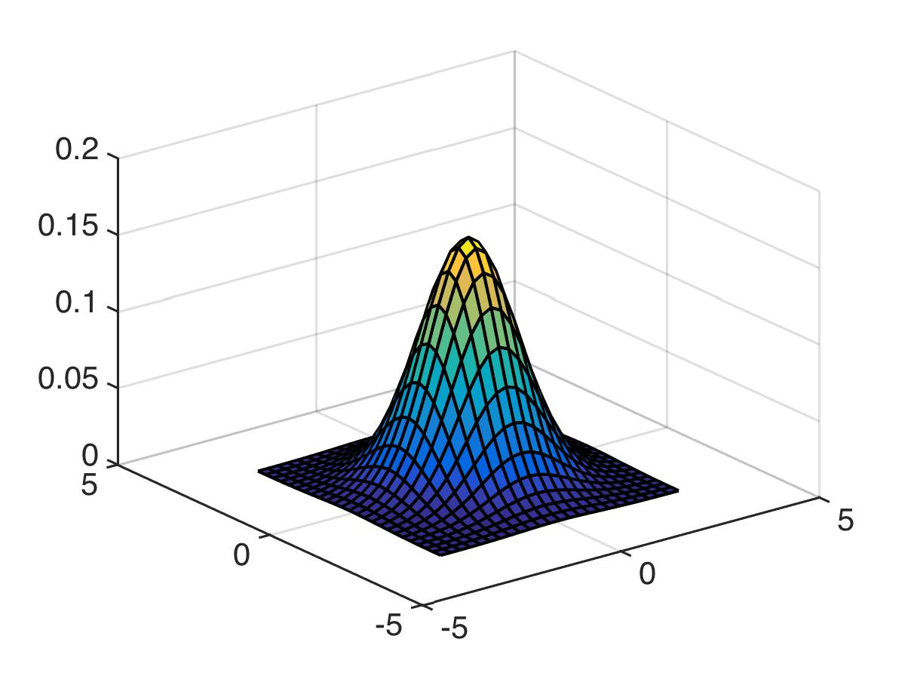
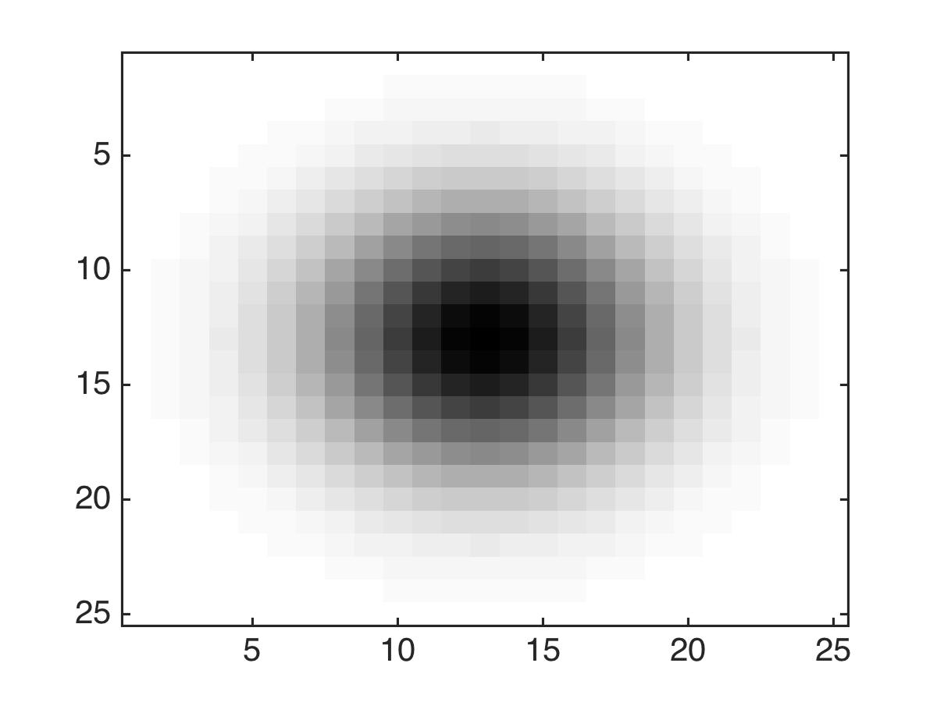
Blurring/Denoising
Convolution with a filter (usually Gaussian).
Notes:
Image processing is a very well studied and highly mature field. We’re just going to give you an overview of some fun topics within it. Blurring for the purpose of denoising is obviously one of the *most* popular things people do with images. So let’s tell you how that works. And it involves convolution with what’s called a filter. The filter is usually gaussian. So what I’ve plotted on the left is a 2d gaussian, and on the right, I’m looking at it from above. So there are larger values in the middle and lower values around the outside. And I’m going to take this gaussian, and *convolve* it with an image. I’m going to tell you what that means but I need to back up a little bit.

Slide 6
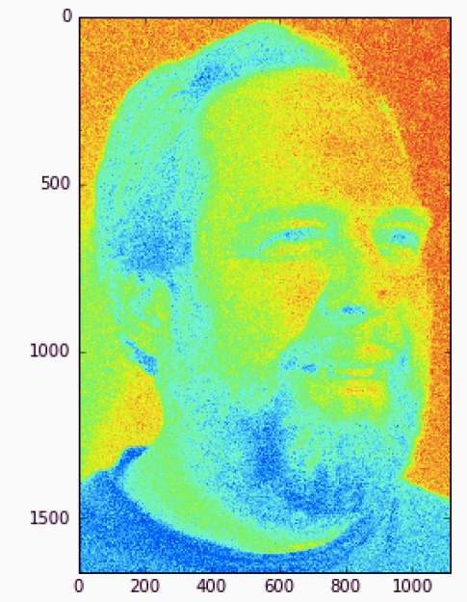
Blurring/Denoising
Convolution with a filter (usually Gaussian).
pixel intensity is between 0 and 255.
Notes:
Well, let’s take an image. So here’s Steve, and *click* he’s made of pixels, each with an intensity between 0 and 255. Now, I want to do some denoising of this image, so let me zoom in a bit on it so you can see where the noise is.

Slide 7
Blurring/Denoising
Convolution with a filter (usually Gaussian).
Notes:
So there, I zoomed in on Steve’s forehead and you can see that a bit of blurring on this image might really help. So what’s the simplest way I can think of to get rid of noise and smooth out the signal? What about replacing the center of each square with the average of the pixel intensities in the whole square? Sounds reasonable. So let’s try that.

Slide 8
Blurring/Denoising
How would I take a simple average of these pixel intensities?
Average(
) =
Notes:
So how would I take an average? *click* Well, I could take the image
multiply each pixel intensity by
1/the number of pixels, that’s how we take a simple average, and add them up. Then we have the average pixel value in the square and we could replace the middle pixel in the image by its average. So what could be the disadvantages of that? Well, one issue is that we’re trying to estimate what should go in the middle of the square. And it should depend more on the pixels near the middle of the square than on the outside of the square. Now you see, we can solve this. Instead of just having an average where we weight each square equally,

Slide 9
Blurring/Denoising
How would I take a simple average of these pixel intensities?
Average(
) =
What about a weighted average that looks more at the local neighborhood?
Weighted
Average(
) =
Notes:
Then we could have the center pixels weighted more highly than the outside pixels. And that’s where we need that Gaussian. It becomes our weighting function. We take a *weighted* average of the pixels, where the center is weighted more highly.

Slide 10
Blurring/Denoising
Convolution with a filter (usually Gaussian).
Notes:
Now we need to do this for every pixel in the image. So let’s do it.

Slide 11
Blurring/Denoising
Convolution with a filter (usually Gaussian).
Computes a weighted average of pixels
Notes:
We need to put the gaussian at each spot on the image, take a weighted average of the pixels. The pixels in the nearby area are each weighted according to the height of the gaussian. And that’ll be the new intensity for that point in the center. And we have to do this for all of the pixels, so we have to move that gaussian around the whole image, which is called a convolution. I’ll show you the result in a minute, but let’s just show you how to do the convolution

Slide 12
Blurring/Denoising
Convolution with a filter (usually Gaussian).
Notes:
So we move it here, compute the weighted average, replace the intensity of the point in the center, and keep going.

Slide 13
Blurring/Denoising
Convolution with a filter (usually Gaussian).

Slide 14
Blurring/Denoising
Convolution with a filter (usually Gaussian).

Slide 15
Blurring/Denoising
Convolution with a filter (usually Gaussian).

Slide 16
Blurring/Denoising
Convolution with a filter (usually Gaussian).

Slide 17
Blurring/Denoising
Convolution with a filter (usually Gaussian).

Slide 18
Blurring/Denoising
Convolution with a filter (usually Gaussian).

Slide 19
Blurring/Denoising
Convolution with a filter (usually Gaussian).
Notes:
And we keep doing it across the whole image. That’s a convolution.

Slide 20
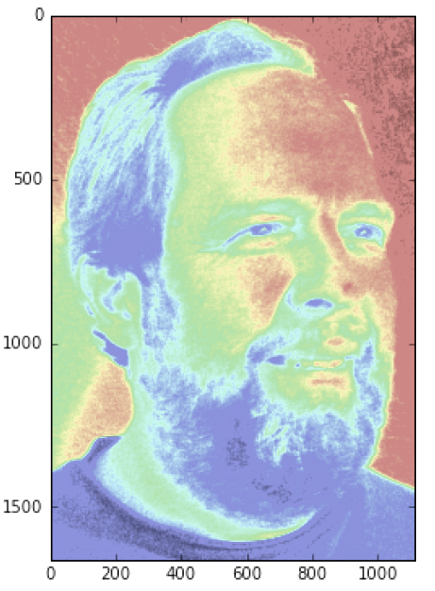
Blurring/Denoising
Convolution with a filter (usually Gaussian).
Notes:
And then the new image that we get perhaps looks something like this, it’s a very smoothed out version of the noisy image.
Now I will warn you that if you make the width of the gaussian too big, it’ll smooth everything out too much and it’ll look weird. If you have too narrow a bandwidth, it just won’t denoise it enough.

Slide 21
Notes:
Ok so that technique works. But another issue it has is that it blurs things you don’t really want blurred, like lines and edges and little details you might want to keep. So let’s try some other stuff. Let’s try an alternative approach to convolving with a gaussian. We’ll try what’s called a median filter next.

Slide 22
Blurring/Denoising
How would I take a simple average of these pixel intensities?
Average(
) =
What about a weighted average that looks more at the local neighborhood?
Weighted
Average(
) =
Notes:
Ok so that technique works. But another issue it has is that it blurs things you don’t really want blurred, like lines and edges and little details you might want to keep. So let’s try some other stuff. Let’s try an alternative approach to convolving with a gaussian. We’ll try what’s called a median filter next.

Slide 24
Blurring/Denoising
What about a median of pixel intensities?
Median(
)
Notes:
In a median filter, instead of taking the average or weighted average of the pixel intensities, we compute the median of the intensities. So why would we want to compute the median rather than computing a weighted average? That seemed like such a good idea at the time. And the answer has to do with preserving edges. Gaussian filters don’t preserve edges, they just blur them out. So what would a median filter do?

Slide 25
Denoising with a Median Filter
Median filters tend to be better at preserving edges than Gaussian filters.
Is the median here dark or light?
Notes:
*read* So I have a question for you. For this pixel right here, we know a weighted average would do. But what would a median filter do? We really want this pixel to stay dark because it’s in a dark region. So would the median here be dark or light?
It’s dark. and in fact none of the light pixel values will matter because we’re computing the median. The median is the middle value. So it doesn’t matter how light the light part is.

Slide 26
Denoising with a Median Filter
Median filters tend to be better at preserving edges than Gaussian filters.
Is the median here dark or light?
Even if this is bright white it won’t affect the median
Notes:
Even if this part is bright white, it won’t affect the median value. But it would affect the mean. And here this dot is pretty close to the boundary between light and dark. And we’ll still call it dark. Which it should be. And the same thing will happen with all of these dark points. They’ll all get colored dark. As long as they are more than half a square away from the edge there, the median will be dark.

Slide 27
Denoising with a Median Filter
So edges will mostly be preserved and we will get smoothing in other places.
Notes:
so this whole thing will be dark. *click* and the rest will be light *click*. And *Read*

Slide 28
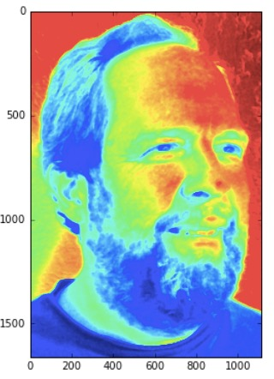
Median
Notes:
Alright, here’s a version of steve with the median filter.

Slide 29
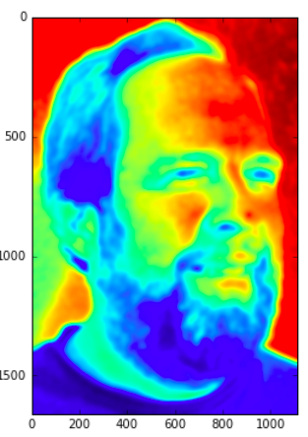
Median
Gaussian
Notes:
And here’s with the gaussian filter – using the same size filter - let’s try to look at the difference. It’s kind of hard to see it if I’m looking at the whole picture, so let’s zoom in to get a detailed view.

Slide 30
Median
Gaussian
Notes:
Let’s zoom into this little corner of the picture. And zoom in.

Slide 31
Median
Gaussian
Notes:
And the gaussian filter looks, well, blurry, and the median one looks much better. You can actually see hairs in there. Some of this could be adjusted by fiddling with the sizes or bandwidths of the filters, but you get the idea.

Slide 32
Notes:
I hope you enjoyed this lecture on denoising with gaussian and median filters.

Slide 33
Edge detection
Notes:
Let’s talk about detecting edges in an image. Let’s go back and revisit the viola and jones example that we discussed in the boosting lecture.

Slide 34
Weak classifiers used by Viola and Jones
Subtract the white areas from the black ones
Notes:
In the paper of Viola and Jones, which is a famous computer vision paper, what you’re supposed to do is move this shape around the image and subtract what’s in the white area from what’s in the black area. So let’s try it.

Slide 35

Weak classifiers used by Viola and Jones
Subtract the white areas from the black ones
Notes:
So this is Steve Elston

Slide 36
Weak classifiers used by Viola and Jones
Subtract the white areas from the black ones
Doesn’t detect anything
Black and white areas are very similar
Notes:
And I put my little detector somewhere on his face. And I subtract what it’s the white area from what’s in the black one, and as it turns out, the pixels look basically the same in the white area and in the black area, so *click* *Read* so when you subtracted them, you get something that’s almost 0.

Slide 37
Weak classifiers used by Viola and Jones
Subtract the white areas from the black ones
Doesn’t detect anything
Black and white areas are very similar
Notes:
let’s try again. I put the little detector on the bottom of Steve’s face, and again the black and white areas are very similar, and the detector can’t see anything.

Slide 38
Weak classifiers used by Viola and Jones
Subtract the white areas from the black ones
Notes:
Ok but now we move the detector over steve’s eyes, and now what happens. The white area is really light-colored, whereas the black area covers his eyes

Slide 39
Weak classifiers used by Viola and Jones
Subtract the white areas from the black ones
Notes:
which are actually dark.

Slide 40
Weak classifiers used by Viola and Jones
Subtract the white areas from the black ones
Now it detects!
Notes:
So when you subtract the areas you get actually a big number. So now the detector makes sense. *clcik* it detects an edge between the eyes and the cheeks. Now the detector I want to discuss with you is not this one in particular. It’s a detector called the sobel edge detector. And it looks similar to the viola and jones detector but it’s a little different.

Slide 41
Sobel Edge Detector
Slightly different than the Viola-Jones filter
Notes:
This is the thing that it convolves with the image. *Read* it is dark on the top and white on the bottom, but also it cares about gradients more in the center of the image than on the outside.
*click* here’s a noisy image, with an edge in it.
Now, Gradient means change. If I move my mouse up over here, not much changes. Same over here. Same over here, until I hit the edge, then the gradient is large, right in here. How do I detect a gradient, I use one of these little edge detectors that we learned about before.

Slide 42
Sobel Edge Detector
Slightly different than the Viola-Jones filter
Notes:
Here it doesn’t detect anything, since when you subtract the white from the black area, you get basically 0.

Slide 43
Sobel Edge Detector
Slightly different than the Viola-Jones filter
Notes:
But here where there is a large gradient, you get a large value when you subtract the pixel intensities, and that’s how it detects an edge.

Slide 44
Sobel Edge Detector
Notes:
*click* Just translating this from grayscale into numerical values, because each color is a number. Let’s make that bigger.

Slide 45
Sobel Edge Detector
Notes:
and there is is. 0 is neutral. And then we have to weigh the top pixels like this, with the middle having the highest weight. And then we have to subtract from that, the pixel intensities on the bottom, with the middle one getting the largest negative weight. This detects edges in the horizontal direction as you saw. There’s also an edge detector for edges going in the vertical direction. You just turn everything sideways.

Slide 46
Sobel Edge Detector
Notes:
You’re probably wondering why we have the 1’s there and the -1’s, why don’t we just have the 2 and the -2, those are for smoothing out the differences. If you just used the middle two it might be sort of unstable.

Slide 47
Sobel Edge Detector
First take the derivative in the x direction
Then smooth it out in the y direction
Notes:
A nice way to see this is to notice that the matrix can be decomposed into these two pieces. If you multiply these together you get the vertical edge detector. Let’s break it down a little.

Slide 48
Sobel Edge Detector
First take the derivative in the x direction
Then smooth it out in the y direction
Notes:
This is literally an edge detector in the vertical direction

Slide 49
Sobel Edge Detector
First take the derivative in the x direction
Then smooth it out in the y direction
Notes:
This is just like a gaussian smoother. Well, not quite gaussian but it’s a bump definitely. It weights the middle more and the outer part less. It’s a weighted average. So it’s definitely smoothing in the vertical direction. Put them together and

Slide 50
Sobel Edge Detector
First take the derivative in the x direction
Then smooth it out in the y direction
Notes:
you get the Sobel edge detector.

Slide 51
Sobel Edge Detector
Image with edges detected in horizontal direction
Image with edges detected in vertical direction
Notes:
click. This notation means the horizontal edge detector convolved with the image. So this is the image with the edges detected in the horizontal direction. *click* we’ll call that Ghorizontal, *click* Here’s the same thing for the vertical edge detector. So you know for each pixel how much of a vertical and horizontal edge is detected in it. And then you can use the pythagorean theorem to get the total magnitude of the edge. And the angle of the edge you can get because you know that the tangent of the angle is just change in y (which is the horizontal detector gradient) over change in x (which is the vertical detector gradient). And you can actually plot these things.

Slide 52
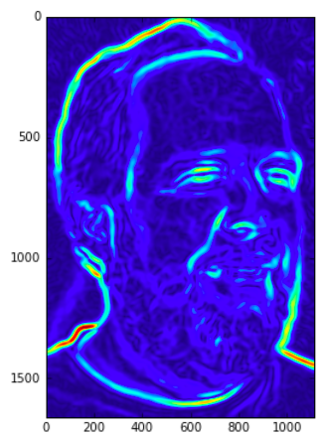
Sobel Edge Detector
Notes:
So here is Steve again, and we’re showing the magnitude of G here. So you can see that all the nice edges have been highlighted.

Slide 54
Harris Corner Detector
Detects corners
Edge detectors don’t work well for corners.
Notes:
Let’s talk about how to detect corners, and in particular we’ll go over the harris corner detection method. The fact is that edge detectors don’t work well for corners because as you saw, edge detectors look for gradients. In corners, there are changes in pixel intensities, but they are in multiple directions.

Slide 55
Harris Corner Detector
Detects corners
Edge detectors don’t work well for corners.
Notes:
Now the Harris corner detector measures the change in intensities as we move a little box around the image. *click and wait for animation*

Slide 56
Harris Corner Detector
This function measures change in intensity across the region when we shift by δ_{x} and δ_{y}.
Notes:
This function is the key to it. What is this function? *click* let me break it down. Right now x and y are the directions in our image.

Slide 57
Harris Corner Detector
This function measures change in intensity across the region when we shift by δ_{x} and δ_{y}.
Notes:
That’s the difference in intensity from shifting. We started from each point in the box x, y and we moved it by deltax deltay. So this is the change in intensity from shifting.

Slide 58
Harris Corner Detector
This function measures change in intensity across the region when we shift by δ_{x} and δ_{y}.
Squared because we care about differences in either direction.
If the intensity is ~constant, this will be ~0.
Notes:
*read*
but if we actually did approach a corner, the change in intensity is going to be fairly high, regardless of which way we approach the corner from.

Slide 59
Harris Corner Detector
This function measures change in intensity across the region when we shift by δ_{x} and δ_{y}.
We choose w(x,y).
Notes:
Now we’ll weight each pixel in the box by some function I get to choose myself. Maybe the weight is 1 *read*

Slide 60
Harris Corner Detector
This function measures change in intensity across the region when we shift by δ_{x} and δ_{y}.
Sum because we want the weighted average of differences over the whole box.
Notes:
And then we sum up the weighed differences within the whole box, and that’s our function E. *click*

Slide 61
Harris Corner Detector
This function measures change in intensity across the region when we shift by δ_{x} and δ_{y}.
Taylor expansion
(plug in)
Use discrete derivatives
Notes:
Now there’s a trick. You see the intensity at the shifted position? We’re going to make an approximation for that using a first order taylor expansion. That looks like this. *clcik* So this is the intensity at the unshifted point, and these are partial derivatives that you can get using discrete derivatives. So everything here you can calculate. *click*. And then if we plus this approximation back into the value of E, you get this *click**

Slide 62
Harris Corner Detector
Notes:
Now why’s that so special?

Slide 63
Harris Corner Detector
Notes:
Well, if you take this expression, you can rewrite it in a really nice way. You can write it as the vector of deltas, times a matrix, times the vector of deltas again. And that matrix is here *click* and it’s something we can calculate. So I’ll just bring the sums in here so you get the idea that Q is just literally 4 numbers that you can just calculate.
Now let’s go back up here to the E function. That function looks familiar. If you set the E function equal to a constant, you get the formula for an ellipse. This over here, when I see something like this, I think “that’s an ellipse”.

Slide 64
Harris Corner Detector
This is the formula for an ellipse
The level sets of the E function are ellipses
Notes:
*click 2*
So what does that mean for the E function? Well, what it means is that if you set E to a constant, you’ll get an equation for an ellipse. In other words *clcik, read*
So we can use that to understand what the E function means and how we’re going to end up with a corner detector. As it turns out, if the E function is very curved, it probably means we have detected a corner in our image.

Slide 65
Harris Corner Detector
E function doesn’t change, likely not a corner.
This is the formula for an ellipse
The level sets of the E function are ellipses
Notes:
So what does it mean when the ellipses are very wide? Well, what it means is that as we move around the image a little bit, the E function doesn’t change very much. So the spot we started from probably isn’t a corner. We’d expect lots of changes at a corner.

Slide 66
Harris Corner Detector
E function increases quickly, likely corner.
This is the formula for an ellipse
The level sets of the E function are ellipses
Notes:
But if the E function changes a lot, it means the intensities are changing a lot as we move even a little bit around the image, so it’s likely to be a corner. And that’s how we classify corners.
But how do you figure out whether the E function is changing a lot or a little? Well, you can look at the ellipses. If the ellipses are wide, not a corner, if they are small, then it’s a corner. But how do you figure out whether the ellipses are wide? And the answer is to look at the eigenvalues of the Q matrix.

Slide 67
Harris Corner Detector
Eigenvalues of Q are related to 1/(principal axes of ellipse).
This means 2 large eigenvalues ➔ image has a corner!
This is the formula for an ellipse
Notes:
*Read* This means that if both of the eigenvalues are large, we have variation in the intensities that isn’t in just one direction, it’s in at least two different directions, which means that it could actually be a corner. And that’s how it works.

Slide 68
Harris Corner Detector
Eigenvalues of Q are related to 1/(principal axes of ellipse).
This means 2 large eigenvalues ➔ image has a corner!
Summary: to detect a corner, compute Q for each x,y. If Q has 2 large eigenvalues, detect a corner.
Notes:
Ok so summarize, to detect a corner, you’d compute Q for each x,y. Then you compute the eigenvalues, or approximate them, and then if both eigenvalues are large, you detect a corner.

Slide 69
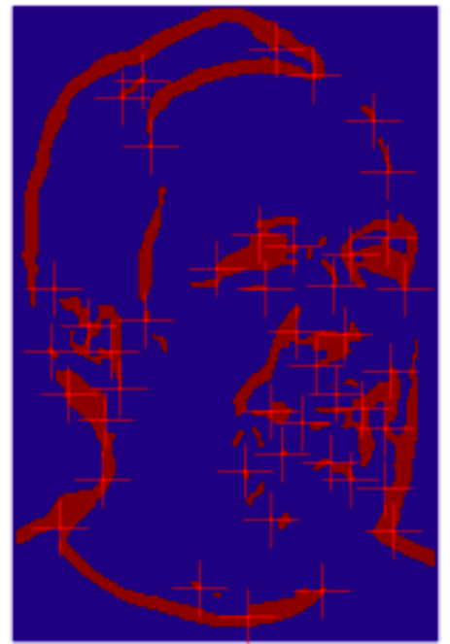
Harris Corner Detector
Notes:
This is an example of the Harris corner detector at work. You can see that it located lots of things that could potentially be corners.

Slide 71
Mathematical Morphology

Slide 72
Dilation and Erosion
Dilation adds a boundary of pixels around a bright object within an image.
Erosion removes a boundary around a bright object within an image.
They require the user to provide a “structuring element”
Notes:
*read* This sounds complicated but it’s really super simple. It’s easier to do this than say the words mathematical morphology three times fast. I’ll show you using an example.
https://robhentac.wordpress.com/2010/09/21/morphological-operations/
http://homepages.inf.ed.ac.uk/rbf/HIPR2/open.htm

Slide 73
Dilation
My “structuring element”
Notes:
I’ve chosen a structuring element. I chose a plus shape but I could have chosen a lot of different shapes. And there’s my image. And I’m going to use that structuring element to do dilation.

Slide 74
Dilation
Color this pixel the darkest (minimum) of the neighbors in the structuring element
Notes:
I will put the structuring element on there, just like that, and I’m going to do a particular operation. *click* I’m going to color the center pixel by the darkest of the neighbors in the shape.
This sounds complicated but it’s really super simple. I’ll show you using an example.
https://robhentac.wordpress.com/2010/09/21/morphological-operations/
http://homepages.inf.ed.ac.uk/rbf/HIPR2/open.htm

Slide 75
Dilation
Color this pixel the darkest (minimum) of the neighbors in the structuring element
Notes:
So this guy right here, he’s going to get colored dark. because there’s a dark pixel covered by the structuring element

Slide 76
Dilation
Notes:
And then I move it over and repeat

Slide 77
Dilation
Color this pixel the darkest (minimum) of the neighbors in the structuring element
Notes:
And I *read*

Slide 78
Dilation
Notes:
This sounds complicated but it’s really super simple. I’ll show you using an example.
https://robhentac.wordpress.com/2010/09/21/morphological-operations/
http://homepages.inf.ed.ac.uk/rbf/HIPR2/open.htm

Slide 79
Dilation
Notes:
This sounds complicated but it’s really super simple. I’ll show you using an example.
https://robhentac.wordpress.com/2010/09/21/morphological-operations/
http://homepages.inf.ed.ac.uk/rbf/HIPR2/open.htm

Slide 80
Dilation
Notes:
This sounds complicated but it’s really super simple. I’ll show you using an example.
https://robhentac.wordpress.com/2010/09/21/morphological-operations/
http://homepages.inf.ed.ac.uk/rbf/HIPR2/open.htm

Slide 81
Dilation
Notes:
This sounds complicated but it’s really super simple. I’ll show you using an example.
https://robhentac.wordpress.com/2010/09/21/morphological-operations/
http://homepages.inf.ed.ac.uk/rbf/HIPR2/open.htm

Slide 82
Dilation
Notes:
It doesn’t do anything here. But I put it there anyway just to show you that you’re supposed to convolve it. You’re supposed to move it all around.

Slide 83
Dilation
Notes:
here’s where we were before, We’ll ideally trace over the whole image, but only the outside of the object matters here. So let me show you what happens when we trace around the object.

Slide 84
Dilation

Slide 85
Dilation

Slide 86
Dilation

Slide 87
Dilation

Slide 88
Dilation

Slide 89
Dilation

Slide 90
Dilation

Slide 91
Dilation

Slide 92
Dilation

Slide 93
Dilation
Notes:
And that’s it.

Slide 94
Dilation
Dilated
Undilated
Notes:
And when we color them all dark, this is what we get. This is what we started with by the way.

Slide 95
Erosion
Notes:
No erosion is sort of the opposite of dilation, but if you do dilation and then erosion, you don’t necessarily get back the same image.

Slide 96
Erosion
Color this pixel the lightest (maximum) of the neighbors in the structuring element
Notes:
For erosion, we’re going to eat away at the pixels in the bright objects. So wherever we put the structuring element we’re going to color the center pixel the lightest out of all of its neighbors.

Slide 97
Erosion
Color this pixel the lightest (maximum) of the neighbors in the structuring element

Slide 98
Erosion
Color this pixel the lightest (maximum) of the neighbors in the structuring element

Slide 99
Erosion
Color this pixel the lightest (maximum) of the neighbors in the structuring element
Notes:
And then it proceeds.

Slide 100
Erosion
Eroded
Uneroded
Notes:
Here’s the final thing we’re left with. Most of the object has been eroded away. And the thing on the right is what we started with,

Slide 101
Erosion
Looks like the outer layer eroded away.
Eroded
Uneroded
Notes:
If I overlay the two you can see that it sort of looks like the outer layer eroded away *click*

Slide 102
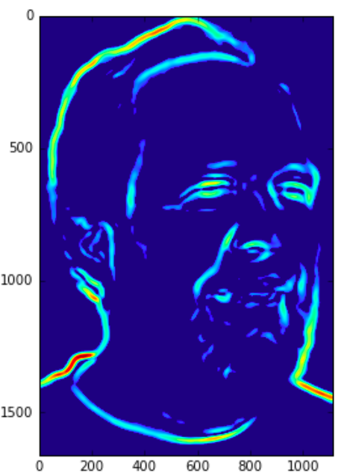
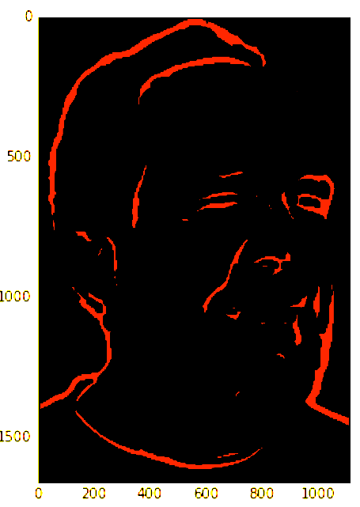
Notes:
Look at his eye, it’s a little more open on this one.

Slide 103
Dilation and Erosion
My “structuring element”
Another “structuring element”
Another “structuring element”
Notes:
*read you could choose whatever shape you like really, depending on how you want the edges eroded around the bright objects.
https://robhentac.wordpress.com/2010/09/21/morphological-operations/
http://homepages.inf.ed.ac.uk/rbf/HIPR2/open.htm

Slide 104
Opening and Closing (from Mathematical Morphology)

Slide 105
Opening Operator (from Mathematical Mophology)
“Opening” is erosion followed by dilation.
Notes:
read, click
Packman on a sandy beach.
When you do erosion, it gets rid of all the sand. All of this little kind of salt noise. But it also gets rid of the outer part of packman. But then the dilation should sort of put it back. Put the outer layer back, but it won’t put the sand back.
http://homepages.inf.ed.ac.uk/rbf/HIPR2/open.htm
http://www.cse.psu.edu/~rtc12/CSE486/lecture06.pdf

Slide 106
Opening Operator (from Mathematical Mophology)
“Opening” is erosion followed by dilation.
Removes “salt” noise.

Slide 107
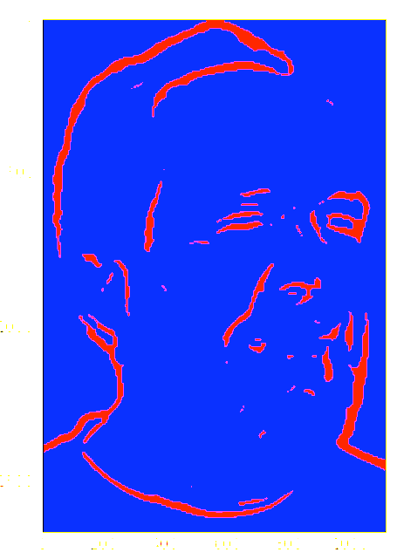
Notes:
Erosion - look at the eye, it’s more open. Also the little eyebrow area, and some of the chin area. The stuff on the chin wont’ come back when we do dilation. The eye will recover nicely.
now do dilation to get the opening operator.

Slide 108
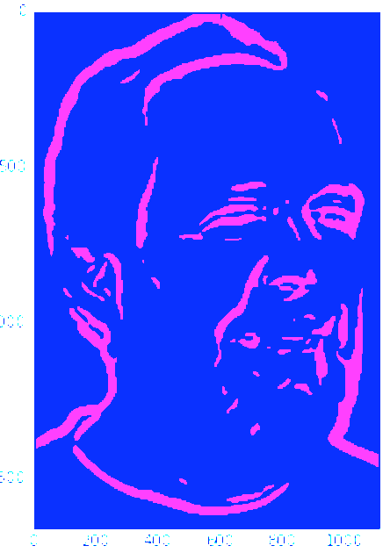
Notes:
And there it is. So the eye looks the same again, same with the eyebrow.
But some of the little salt noise is gone *flip back and forth*

Slide 109
Closing Operator (from Mathematical Mophology)
“Closing” is dilation followed by erosion.
Notes:
The closing operator is dilation followed by erosion. There’s packman again, but this time the noise is on a lighter surface, so this is pepper noise, rather than salt noise. And then when we do dilation, the white part is going to expand and get rid of all the pepper noise, but it’s also going to eat a layer of pixels around packman. So then when we do erosion, it puts that outer layer back around packman, but doesn’t put back the pepper noise.
http://homepages.inf.ed.ac.uk/rbf/HIPR2/open.htm
http://www.cse.psu.edu/~rtc12/CSE486/lecture06.pdf

Slide 110
Closing Operator (from Mathematical Mophology)
“Closing” is dilation followed by erosion.
Removes “pepper” noise.
Notes:
And hopefully you get something that looks like that. So closing removes pepper noise.
http://homepages.inf.ed.ac.uk/rbf/HIPR2/open.htm
http://www.cse.psu.edu/~rtc12/CSE486/lecture06.pdf

Slide 111
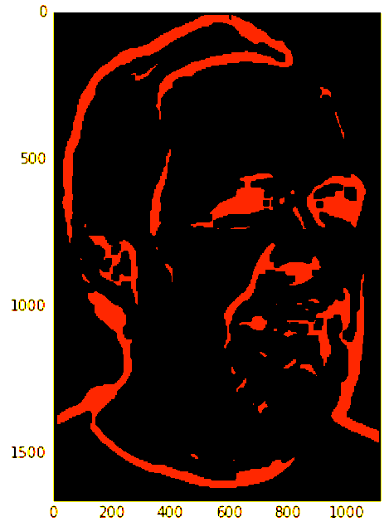
Notes:
So here, it though that Steve’s eyes were pepper noise and colored them in. The dilation step must have colored in Steve’s eyes, and then the erosion step couldn’t recover them.

Slide 112
Use opening and closing to eliminate certain types of noise or shapes.

